Slide 1
Music Recommendation using Collaborative filtering and Matrix factorization
Submitted by: Hardeep singh Submitted to: Sheela Rammana
Student no. : 3089450
Module : Advanced Machine Learning

Slide 2
Contents
Introduction
Explicit data vs implicit data
Related Work
Theoretical Framework
Implementation Details
Experiments
Conclusion
References

Slide 3
Introduction
Recommendation systems are becoming very popular in various fields. Such as, for music and movies websites and for shopping websites.
There are various sites on internet such as Amazon, You Tube, Netflix have developed highly advanced systems for recommending their products.
Matrix factorization techniques has been proven very effective for implementing recommender systems.
Matrix factorization is the popular approach for the matrix completion problem.
Where, alternating least squares is used to learn latent factors of users and items.

Slide 4
Introduction contd..
For experiment purpose, Implicit Audioscrobbler dataset (which is now merged with last.fm) will be used in this paper.
It contains large amount of user data, artist data and play counts by users for various artists.
The best prediction model will be searched by computing different ranks for user and artist latent-factors, which will help in recommending top artists to a user.
The quality of the recommender system will be evaluated by finding Area under the curve.

Slide 5
Explicit vs Implicit data
Explicit data
The data which is collected from the user feedback about a product. E.g Movie rating datasets, where user give ratings to a movie from 1 to 5.
Implicit data
The examples of these kind of data are song listening history, browsing history, search history and purchase history. If a user is listening to a particular song many times, probability is there that the user likes that song.
No negative feedback

Slide 6
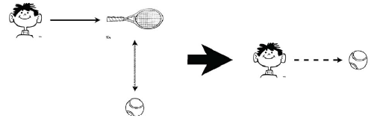
Related Work
Content-based filtering
The primary source of information for such systems is content known about the items in the system.
Fig1. content-based filtering
Fig.1 shows an example of content-based filtering.
This technique was used in text-based applications, to recommend a document or web-site

Slide 7
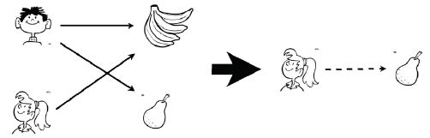
Related work contd..
Collaborative filtering
Collaborative Filtering recommender systems make predictions by looking user-item relations, without requiring any additional information about the users or items.
Fig2. collaborative filtering
Fig.2 shows an example of collaborative filtering

Slide 8
Related Work cont..
There are two most common approaches for implementing Collaborative filtering
Neighborhood-based model
The user based approach look at what other users with similar behaviors when making recommendations. Neighborhood-based model combined with Pearson correlation or cosine similarity to find predicted values.
Limitations.
When it comes to large datasets such as implicit feedback which contains very sparse ratings.
neighborhood-based models experience difficulties in finding the right match and produce a weak recommendations to users

Slide 9
Related Work cont..
Latent factor model.
Latent factor model for recommendation systems utilize the user-item rating matrix to try to characterize both user and items by a number of latent features.
The factor vectors for a user and item can be multiplied together to give predicted rating for the item or vice versa.
In the context of music, latent factors can be of users and artists which will be extracted from the large implicit feedback datasets.
An effective latent factor method for recommender systems is matrix factorization.
It will help in overcoming the problem of scalability in large datasets faced in neighborhood-based models.

Slide 10
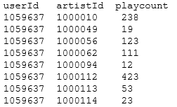
Theoretical Framework
Dataset analysis
Audioscrobbler dataset only have the information about how many times a user played songs of a given artist and the names of artists.
141k unique users
1.6 million unique artists.
24.2 million users’ plays of artist, along with their count.
The reduced dataset contains top 50 users with highest artist play counts.
The dataset contains 3 files.
User_artist_data_small.txt: It contains 3 features userId, artistId and playcount as shown in Fig.3.
Fig3. Data format

Slide 11
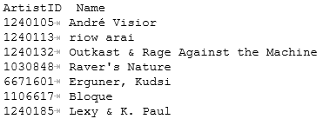
Theoretical Framework contd..
Artist_data_small.txt: It contains two features ArtistId and Name as shown in the Fig 4. It provides names of each artist by their ID's.
Fig 4. Data Format
Artist_alias_small.txt: When plays are scrobbled, the client application registers the name of the artist being played. This data file contains two features MisspelledArtistID and StandardArtistID.

Slide 12
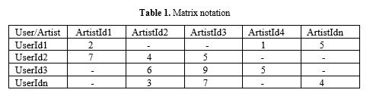
Theoretical Framework contd..
Matrix notation
Our experiment will focus on the artist and the user entity. Artist data and user play counts were available in different data formats.
Table 1. Shows the matrix notation that will be used in this recommendation system.

Slide 13
Theoretical Framework contd..
Matrix Factorization
Matrix factorization is a popular approach for matrix completion problem, where it summarize users and items with their latent factors. The recommendation is based on high correspondence between user and item latent factors.
In our music recommender system, r_{ui} indicates how many times user, u listened to artist i.
In general, as r_{ui} grows, it gives strong indication that user likes that item.
Consequently, a set of variables c_{ui} is introduced to measure confidence in observing p_{ui} .
c_{ui} = 1+ r_{ui} (1)
Where,  is a parameter applicable to the implicit feedback variant matrix factorization that governs baseline confidence in preference observations.

Slide 14
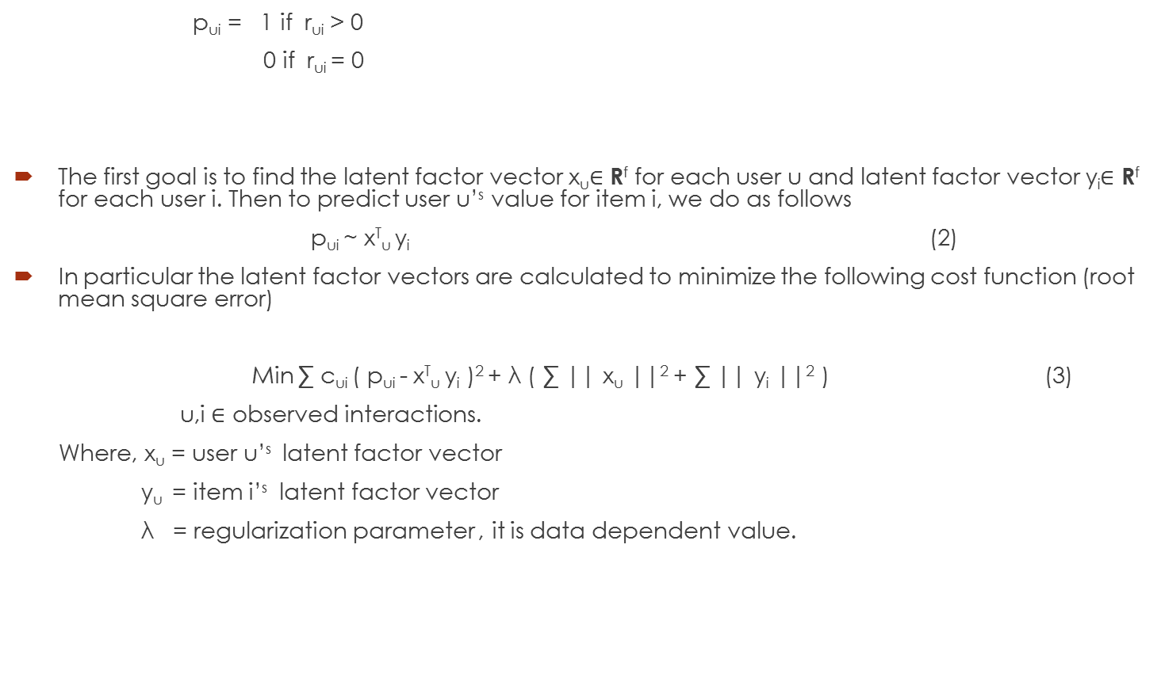
Theoretical Framework contd..
p_{ui} = 1 if r_{ui} > 0
0 if r_{ui} = 0
The first goal is to find the latent factor vector x_{u}$∈$ R^{f} for each user u and latent factor vector y_{i}$∈$ R^{f} for each user i. Then to predict user u’^{s} value for item i, we do as follows
p_{ui} ~ x^{T}_{u} y_{i} (2)
In particular the latent factor vectors are calculated to minimize the following cost function (root mean square error)
Min ∑ c_{ui} ( p_{ui} - x^{T}_{u} y_{i} )² + λ ( ∑ || x_{u} ||² + ∑ || y_{i} ||² ) (3)
u,i $∈$ observed interactions.
Where, x_{u} = user u’^{s} latent factor vector
y_{u} = item i’^{s} latent factor vector
λ = regularization parameter , it is data dependent value.

Slide 15
Theoretical Framework contd..
Alternating least square (ALS)
The approach for ALS is to fix latent factor vector y_{i} and optimize x_{u} latent factor vector then to fix x_{u} and optimize y_{i}, and repeat until convergence.
If artist i listened by user u then 1 else o
1 0 0 0 1 0
0 0 1 0 0 1 ~ x_{u} [ y^{T}_{i} ]
1 0 1 0 0 0
Fix artists latent vector

Slide 16
Theoretical Framework contd..
Alternating least square (ALS)
The approach for ALS is to fix latent factor vector y_{i} and optimize x_{u} latent factor vector then to fix x_{u} and optimize y_{u}, and repeat until convergence.
If artist i listened by user u then 1 else o
solve for user,x_{u} = ( Y^{T} C^{u} Y + λ I )⁻¹ Y^{T} C^{u} p(u)
1 0 0 0 1 0
0 0 1 0 0 1 ~ x_{u} [ y^{T}_{i} ]
1 0 1 0 0 0
Fix artists latent vector

Slide 17
Theoretical Framework contd..
Alternating least square (ALS)
The approach for ALS is to fix latent factor vector y_{i} and optimize x_{u} latent factor vector then to fix x_{u} and optimize y_{u}, and repeat until convergence.
If artist i listened by user u then 1 else o
fix for user,x_{u}
1 0 0 0 1 0
0 0 1 0 0 1 ~ x_{u} [ y^{T}_{i} ]
1 0 1 0 0 0

Slide 18
Theoretical Framework contd..
Alternating least square (ALS)
The approach for ALS is to fix latent factor vector y_{i} and optimize x_{u} latent factor vector then to fix x_{u} and optimize y_{i}, and repeat until convergence.
If artist i listened by user u then 1 else o
fix for user,x_{u}
1 0 0 0 1 0
0 0 1 0 0 1 ~ x_{u} [ y^{T}_{i} ]
1 0 1 0 0 0
solve for artists, y_{i} = ( X^{T} C^{i} X + λ I )⁻¹ X^{T} C^{i} p(i)
Repeat this until convergence

Slide 19
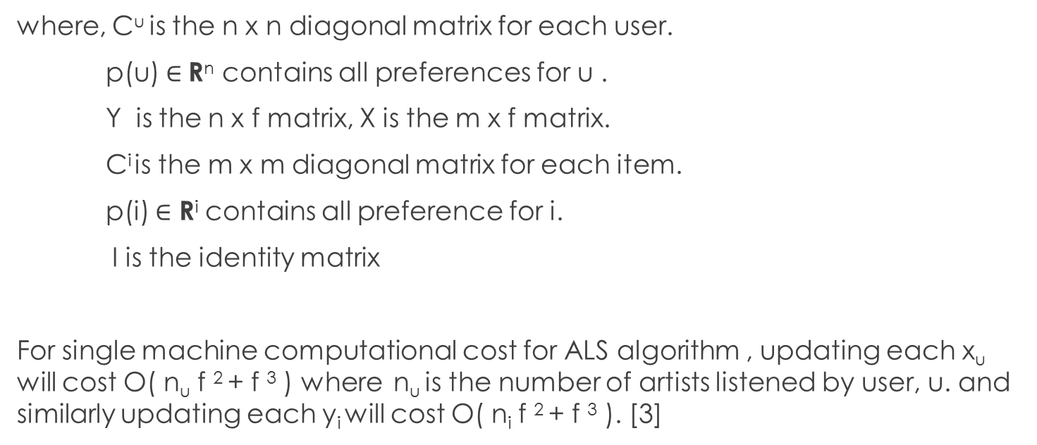
Theoretical Framework contd..
where, C^{u} is the n x n diagonal matrix for each user.
p(u)$∈$ R^{n} contains all preferences for u .
Y is the n x f matrix, X is the m x f matrix.
C^{i} is the m x m diagonal matrix for each item.
p(i) $∈$ R^{i} contains all preference for i.
I is the identity matrix
For single machine computational cost for ALS algorithm , updating each x_{u} will cost O( n_{u} f ² + f ³ ) where n_{u} is the number of artists listened by user, u. and similarly updating each y_{i} will cost O( n_{i} f ² + f ³ ). [3]

Slide 20
Implementation
System specification
Hardware used: Dell Laptop
Intel i5 processor
4 GB RAM
750 GB Hard Disk
Software used:
Apache Spark version -2.0.0-bin-hadoop2.6
Jupyter notebook (anaconda version 4.3.1)
Python version 2.7
Microsoft Windows 10
Language used: Python along with spark libraries.

Slide 21
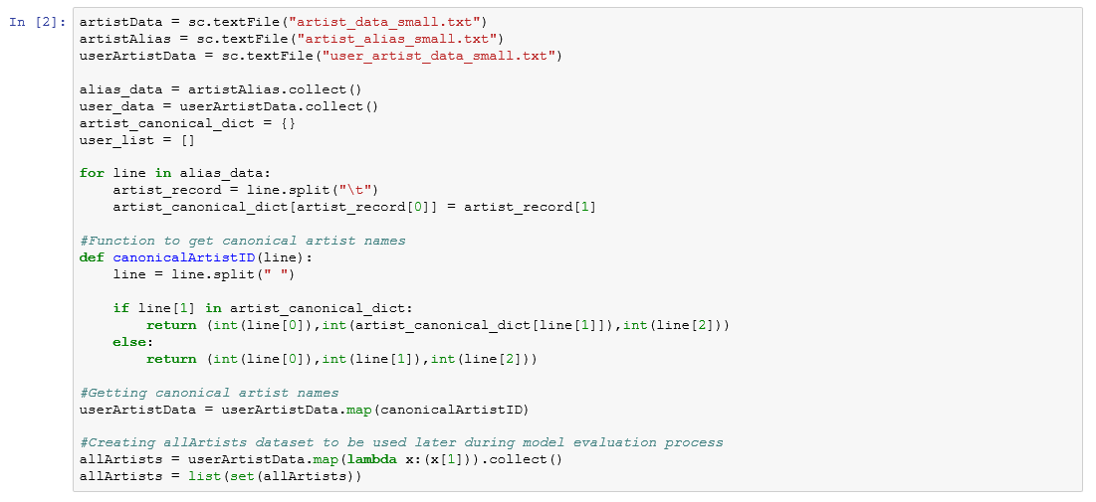
Implementation contd…
Loading all three datasets
First of all, code is for loading three data files userArtistData, artistAlias, and artistData into RDD’s. Where RDD is Resilient Distributed Datasets which is a fundamental data structure of Spark.
Fig 5. Loading Data

Slide 22
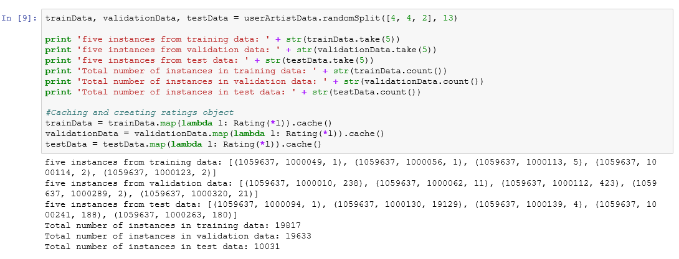
Implementation contd…
Splitting data into training, validation and test data
The trainData will be used to train the model. validationData will be used to perform parameter tuning and testData is used for a final evaluation of the model.
Fig 6. Splitting data
Fig 6. Shows that the data split is done by the randomSplit function of spark. Where the userArtistData is divided into trainData (40%), ValidationData (40%) and testData (20%). In the output section, five instances of each data is printed along with instances count.

Slide 23
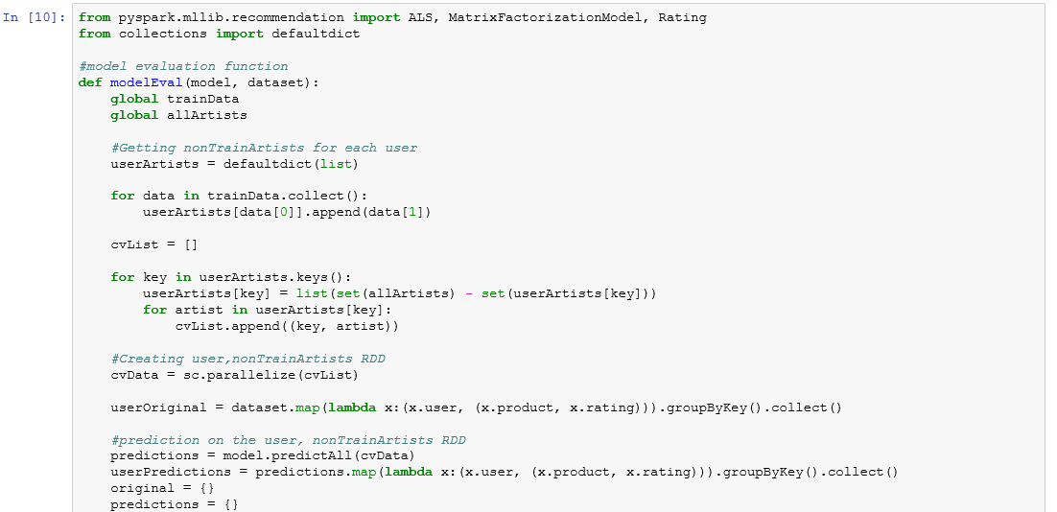
Implementation contd…
Recommender model evaluation
This model can be used to predict the top X artist recommendations for a user and the recommendations coming from this model can be compared to the artists that user actually listened to. After that, the fraction of overlap between the top X predictions pf the model and the X artists that the user actually listened is to be calculated. This process will be repeated for all the users and average will be returned.

Slide 24
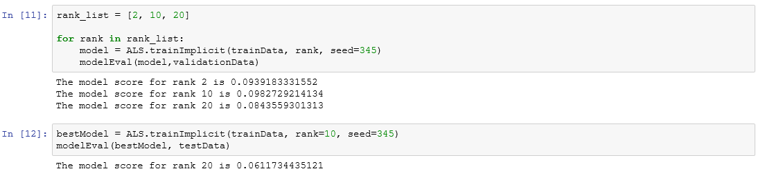
Implementation contd…
Model construction
Fig 8 shows the model build using validationData and modelEval function. The output showing the model score for rank 2, 10 and 20. Where, rank is the number of latent factors calculated using ALS. In the 2nd output the bestModel is computed using testData.
Fig 8. Model construction
^{Code:-} https://github.com/ParinSanghavi/Music-Recommender-System-using-Apache-Spark-and-Python/blob/master/prsangha_recommender.ipynb

Slide 25
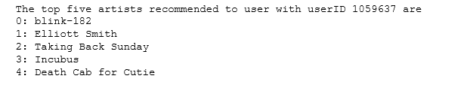
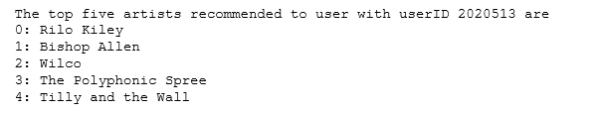
Experiments
Experiment 1
We are going to use the bestModel, which we calculated above section to predict the top 5 artists for 2 different users using recommendProducts function and by mapping the results into the real name using artistAlias.
Fig 9. Recommendation result1
Fig.10 Recommendation result2

Slide 26
Experiments contd..
Experiment 2.
The approach is to evaluate a recommender based on its ability to rank good artists high in the recommendation list.
AUC (Area Under the Curve) can be used as a metric to evaluate model. It can also viewed as the probability that a randomly-chosen good artist ranks above a randomly chosen bad artist.
Fig. 11. Evaluation model
The result is 0.9632 (approx.). It is clearly higher than the 0.5 that was expected from making recommendations randomly. It is close to maximum score 1.0. Therefore, AUC over 0.9 would be considered high[10].

Slide 27
Conclusion
The matrix factorization using Alternating least square (ALS) learning method can be used to recommend music to users from implicit feedback data.
The Apache-Spark with Python can be used for constructing recommender systems as we can use various machine learning libraries provided by Spark.
Moreover, the quality of the recommendation system can be evaluated by computing area under the curve.
Recommendation systems in future can use ALS for learning latent factor vectors for ever increasing implicit feedback data.

Slide 28
References
J. Bennet and S. Lanning, “The Netflix Prize”, KDD Cup and Workshop, 2007. www.netflixprize.com.
Francesco Ricci, Lior Rokach, and Bracha Shapira. Introduction to recommender systems handbook. Springer, 2011.
Yifan Hu, Yehuda Koren, and Chris Volinsky. Collaborative filtering for implicit feedback datasets. In Data Mining, 2008. ICDM'08.Eighth IEEE International Conference.
D.W. Oard and J. Kim, “Implicit Feedback for Recommender Systems”, Proc. 5th DELOS Workshop on Filtering and Collaborative Filtering, pp. 31–36, 1998.
Gediminas Adomavicius and Alexander Tuzhilin. Toward the next generation of recommender systems: A survey of the state-of-the-art and possible extensions. Knowledge and Data Engineering, IEEE Transactions on, 17(6):734{749, 2005.
Pasquale Lops, Marco De Gemmis, and Giovanni Semeraro. Contentbased recommender systems: State of the art and trends. In Recommender systems handbook, pages 73{105. Springer, 2011.
Yehuda Koren, Robert Bell, and Chris Volinsky. Matrix factorization techniques for recommender systems. Computer, (8):30{37, 2009.
Badrul Sarwar, George Karypis, Joseph Konstan, and John Riedl.Item-based collabrative filtering recommendation algorithms. In Proceedings of the 10th international conference on World Wide Web,pages 285{295. ACM, 2001.
Original Dataset : http://www-etud.iro.umontreal.ca/~bergstrj/audioscrobbler_data.html
https://books.google.ca/books?id=WE_GBwAAQBAJ&pg=PA40&lpg=PA40&dq=audioscrobbler+dataset&source=bl&ots=vCDdD8DZZZ&sig=fyCisF0Fl-9Z-3g5tot7kdZ8gVg&hl=en&sa=X&sqi=2&ved=0ahUKEwiIxvnWmfzSAhWr5IMKHX60Dd8Q6AEITzAJ#v=onepage&q&f=false
(Advanced analysis with SPARK[book])

Slide 29
Thank you
.

